Slide 1
Design and Implementation of ATP Machine Controller
GROUP NAME: SINGLETON
NIVETHITHA R
INTEL UNNATI INDUSTRIAL TRAINING

Slide 2
DESCRIPTION:
ATPs are designed to collect
payment from consumers by cash,
cheque, or DD.
It will be unmanned and can be operated
by the customers 24/7.
It accepts cash/cheque/DD/pay orders, issues an
acknowledgment on every payment made and is a touchscreen
and multimedia-based system.

Slide 3
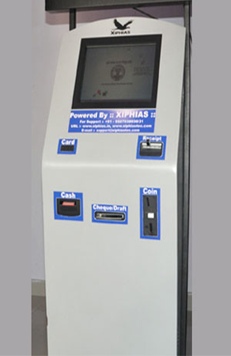
IMAGE:

Slide 4
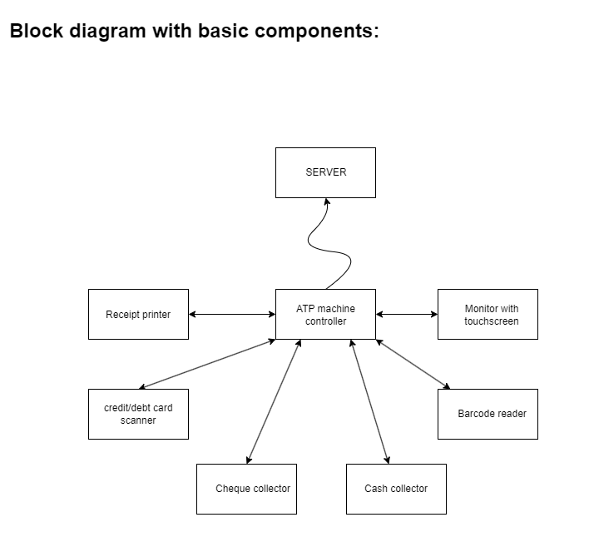
BLOCK DIAGRAM:

Slide 5
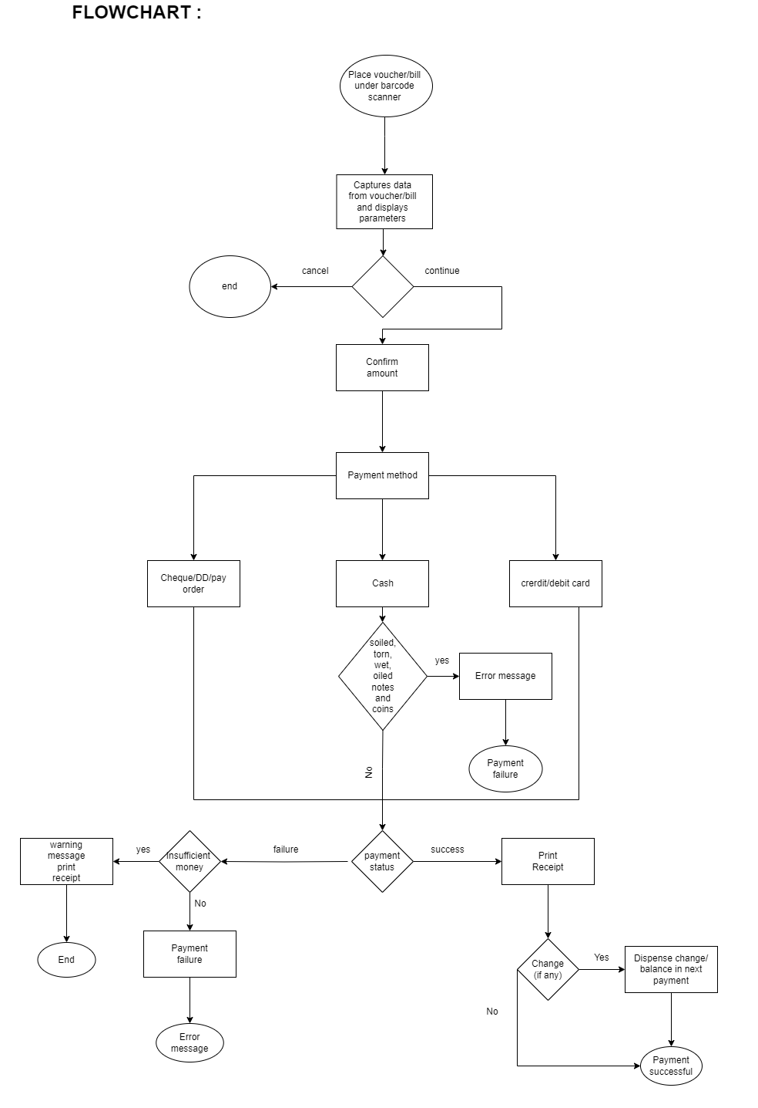
FLOWCHART:

